Slide 1
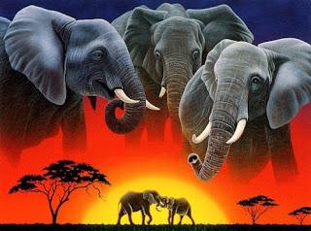
+
963

Slide 2
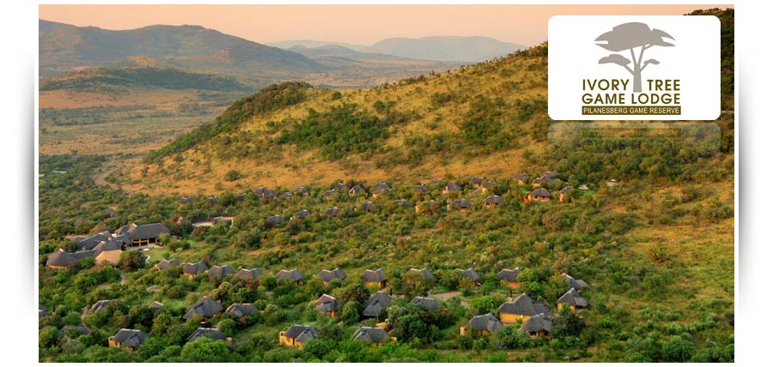

OPTION 1: IVORY TREE GAME LODGE
Ivory Tree Game Lodge is situated in the north eastern region of the Pilanesberg National Park.
Nestled in the basin of an ancient amphitheatre divided by riverine woodlands and elephant trails lies an exclusive private game lodge. Ivory Tree uses custom built 10 seater open game viewers which permit maximum all around visibility. An abundance of wildlife proliferates in 580km of diverse and arresting bushveld terrain. The park is home to healthy populations of lions, leopard, black and white rhino, elephant and buffalo – Africa’s Big 5.

Slide 3
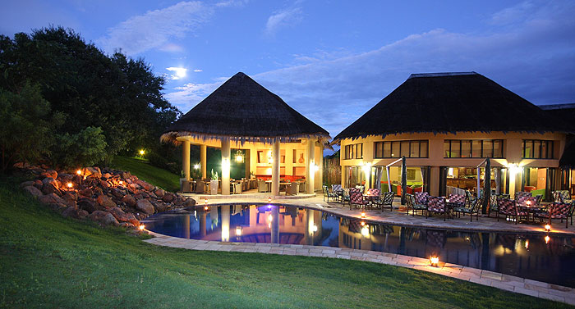
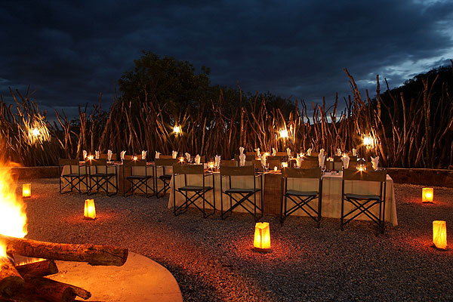
All 57 rooms are en-suite and with outdoor shower, an air-conditioner, covered patio, mini bar and tea and coffee making facilities. The standard accommodation configuration includes two twin beds.

Slide 4
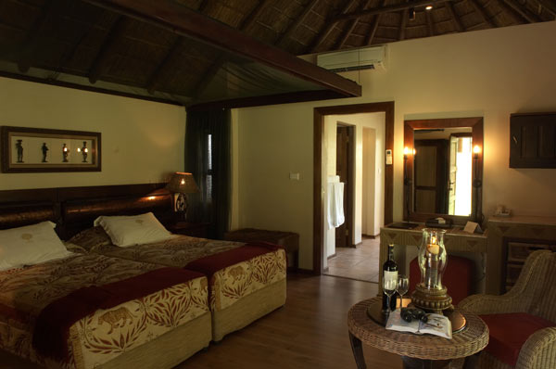
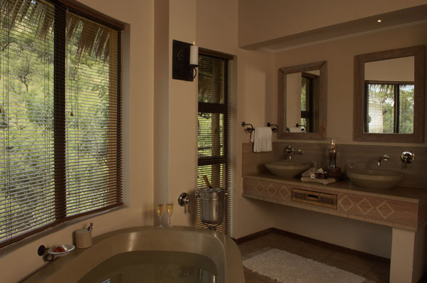
Amani African Spa at Ivory Tree Game Lodge is the ultimate escape for pure self-indulgence. A banquet for the soul and senses using our unique Spa product brand, Africology, made from the purest of ingredients, free from artificial preservatives, colouring & fragrances.

Slide 5
Included:
Accommodation en-suite
Breakfast, lunch and dinner
Two daily scheduled game drives
Excluded:
Beverages
Curio shop purchases
Laundry
Spa treatments
Items of a personal nature
Park entry fee
COST: R12 200.00 per person sharing twin / R 18 300.00 per person in a single for a 4 night stay

Slide 6
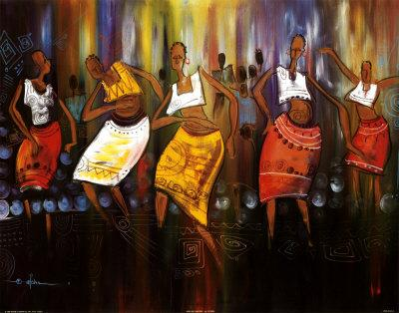
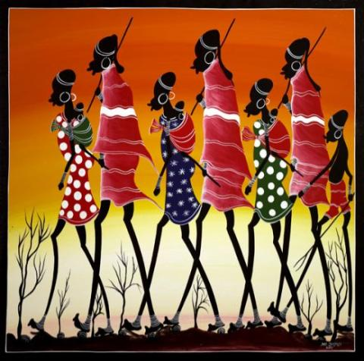

Slide 7
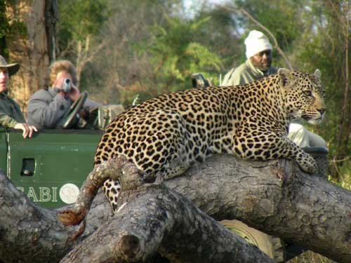
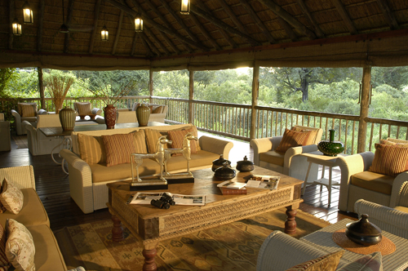
OPTION 2: SABI SABI BUSH LODGE – SABI SANDS GAME RESERVE
Deep in the African bushveld, within South Africa's famous Sabi Sand Reserve, 'something enchanting lies in wait' - the Sabi Sabi Private Game Reserve. This award winning private game reserve offers world-class standards in luxury accommodation, exceptional close wildlife encounters, personal service and delicious cuisine. For decades Bush Lodge has been Sabi Sabi's flagship lodge, famed for its warmth, vibrancy and legendary hospitality. A favourite amongst travellers in search of luxury accommodation, Bush Lodge is a luxurious safari escape set in the heart of the Sabi Sabi bushveld overlooking a waterhole and an African plain.

Slide 8
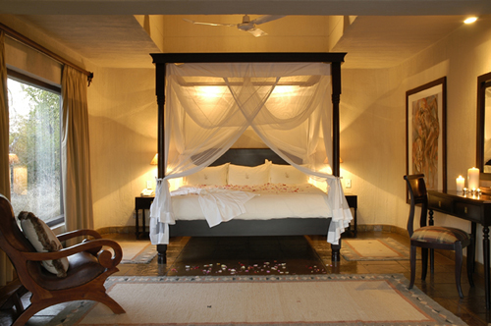
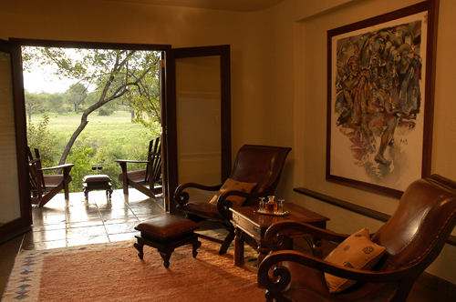
Each of the 25 spacious, air-conditioned thatched suites is beautifully appointed, featuring exquisite ethnic décor in keeping with the bushveld environment. The en-suite bathrooms feature al-fresco as well as glass-fronted indoor showers, affording wonderful views of the bushveld. Huge viewing decks are the ideal setting to relax while spotting game, bird watching, or cooling off in the filtered pools. Meals, including the wonderful dinners in the open air boma, are heralded by blasts on a kudu horn, a summoning to delicious food.

Slide 9
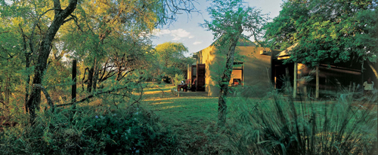
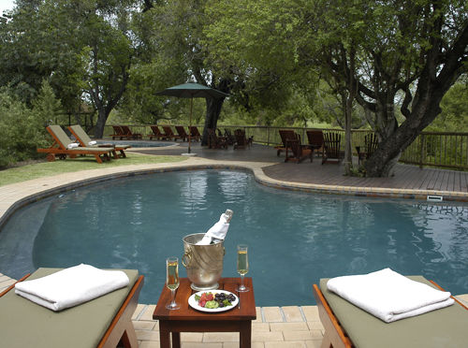
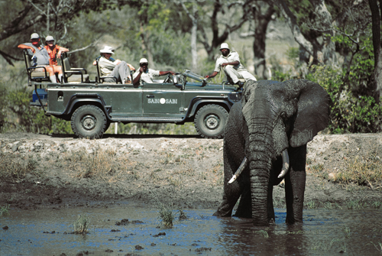
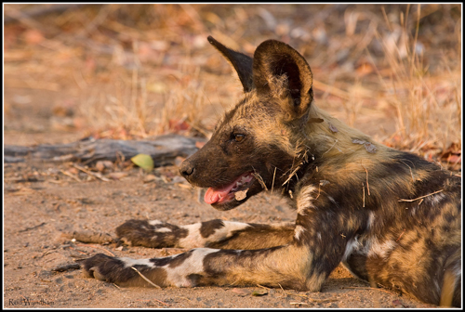

Slide 10
Included:
Luxury en-suite accommodation
Open Land Rover safaris by day and at night to see Africa's big game accompanied by qualified rangers and Shangaan trackers
Environmental awareness walking safaris
Breakfast, lunch and "boma" dinner
Selected beverages and South African house wines
Return shuttle flight from ORTIA to Sabi Sands Private Game Reserve
Excluded:
Spa treatments at Amani Spa
Cellar wine collection / Premium brands
Curio shop purchases / Telephone calls
Laundry
Sabi Sand Conservation fee – currently R50.00per person
COST: R21 040.00 per person sharing twin / R34 040.00 per person in a single for a 3 night stay

Slide 11
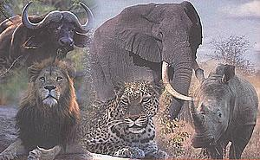

Slide 12
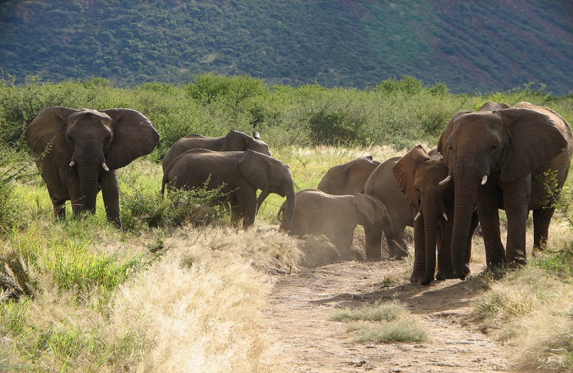
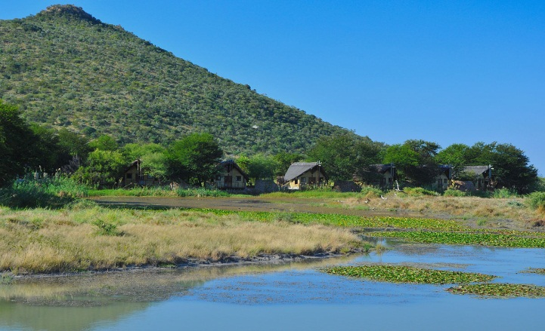
OPTION 3: TAU GAME LODGE – MADIKWE GAME RESERVE
Situated in the malaria free Madikwe Game Reserve. Ten thousand animals of 27 major species, including wild dog, cheetah, lion, white and black rhino, buffalo and elephant roam around here freely.
The accommodation consists of 30 luxury thatched chalets, all with views of the game approaching the water hole. Each chalet ensures privacy with its own viewing deck, en suite bathroom, open-air shower, air-conditioning and ceiling fans.

Slide 13
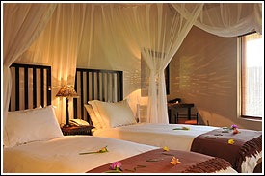
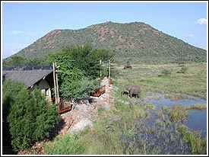
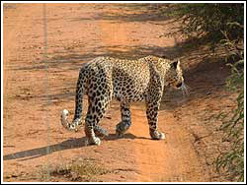
The main body of the Lodge is two-leveled and has a comfortable lounge, bar and dining room which are semi open-air and overlook the waterhole. Delicious buffet breakfasts and lunches are generally served in the main building or on the verandah next to the plunge pool and dinner is served in one of the cozy boma's under the stars, or in the lapa next to the main lodge.
Included:
Accommodation in a chalet en-suite for 4 nights
Three delicious buffet meals daily
Two game drives per day in open land rovers guided by experienced Rangers including sundowners drinks
Excluded:
Conservation levy
Government Bed levy
Telephone calls / Spa services / Curio purchases / Bar purchases / Laundry
Transport JNB to Madikwe return – this can be advised at time of booking in accordance with amount of guests
COST: R13 200.00 per person sharing twin / R15 840.00 per person in a single for a 4 night stay

Slide 14
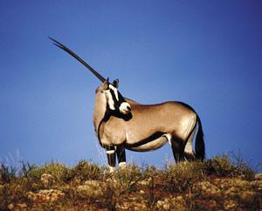
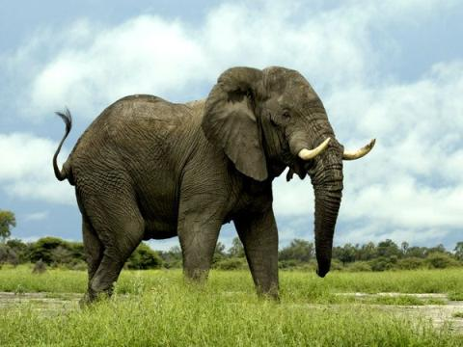
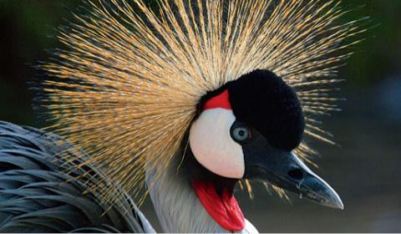

Slide 15
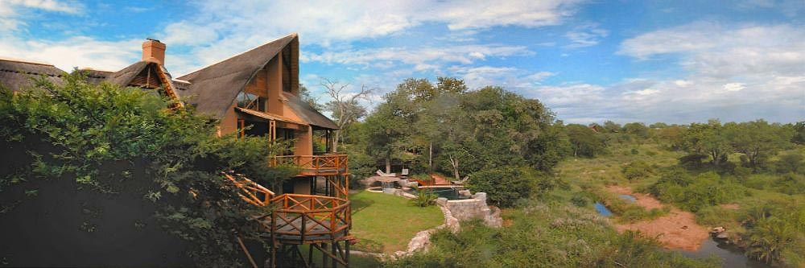
OPTION 4: LUKIMBI SAFARI LODGE - KRUGER NATIONAL PARK
Kruger is home to the Big Five and a wide variety of other animals and birds, which roam freely in their natural habitat. Lukimbi concession is the place to enjoy wonderful walks, because it is so large and unspoiled.
The main buildings are linked together with open wooden decks, making the most of the view, as the lodge meanders along the banks of the river Lwakahle. Lukimbi is proud to serve South African wines and wine tasting is held most evenings before dinner. This gives guests the chance to sample before choosing the wines offered. Meals both unusual and beautifully presented add to the whole enjoyable Lukimbi experience. Part of the fun is the changing of venues, so guests may enjoy breakfast in the bush, lunch round the pool and a glamorous candlelit dinner on the wooden decks.

Slide 16
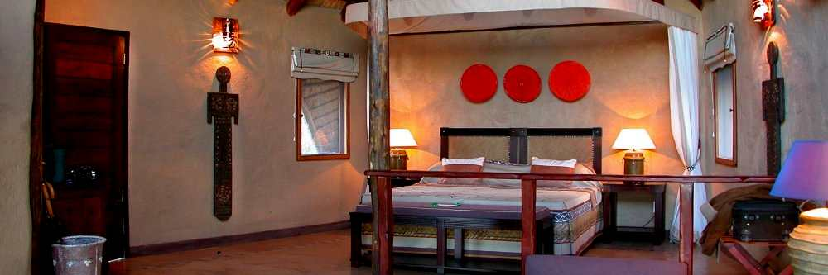
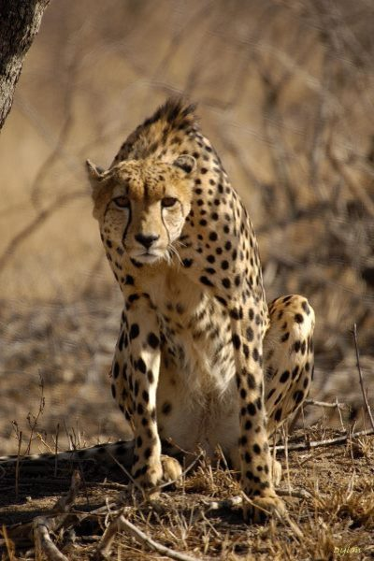
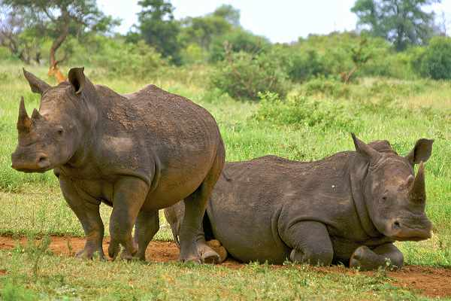
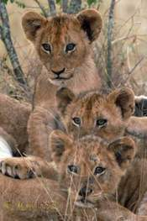
Raised walkways lead guests to 16 spacious suites, all combining luxury and modern African decor with stunning river views. All suites are air-conditioned, have fans, safes, mini bars, as well as tea and coffee facilities. Private decks leading out towards the river provide the ideal place to relax or enjoy bird spotting and game viewing in peace and tranquility.

Slide 17
Included:
Luxury accommodation en-suite for 4 nights
Three Meals per day
Tea and Coffee
Afternoon Tea
Two Game Drives Daily
Excluded:
Beverages
Telephone and fax calls
Curios
Gratuities
Entrance fee into the Kruger National Park
Scheduled SAA Flight JNB to Nelspruit – transfer Nelspruit to Lukimbi return
COST: R 15 960.00 per person sharing a twin or in a single for 4 night stay (minimum 4 night stay for no single surcharge)

Slide 18
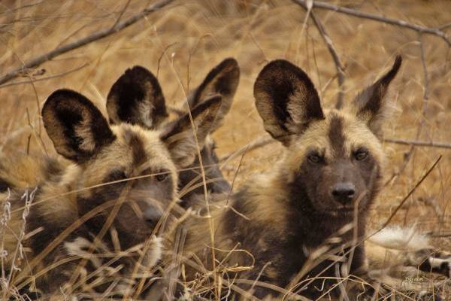
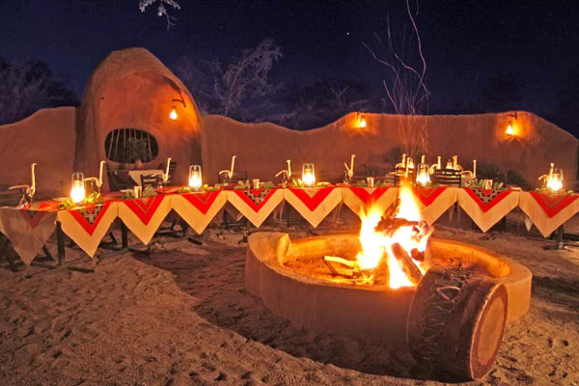
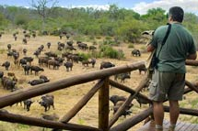

Slide 19
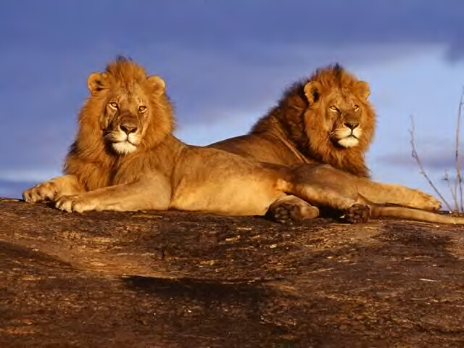
“You know you are truly alive when you’re living among lions”

